Slide 1

Toyota Executive Scrum Board
Team 2 – CS 499 – 001 – Fall 2017

Slide 2




Team Members
Logan Hickey
Communications/Scrum Manager
Thomas Wheeler
Project Manager
Jonah Starling
Front End Lead
Irsyad Hanif
Back End Lead

Slide 3

Problem Statement
Low Tech (cluttered thoughts)
Teleconference Communication
Communication with Engineers

Slide 4
Proposed System
Cross Platform Design
High Tech, Scalable Environment
Toyota Branded Design

Slide 5
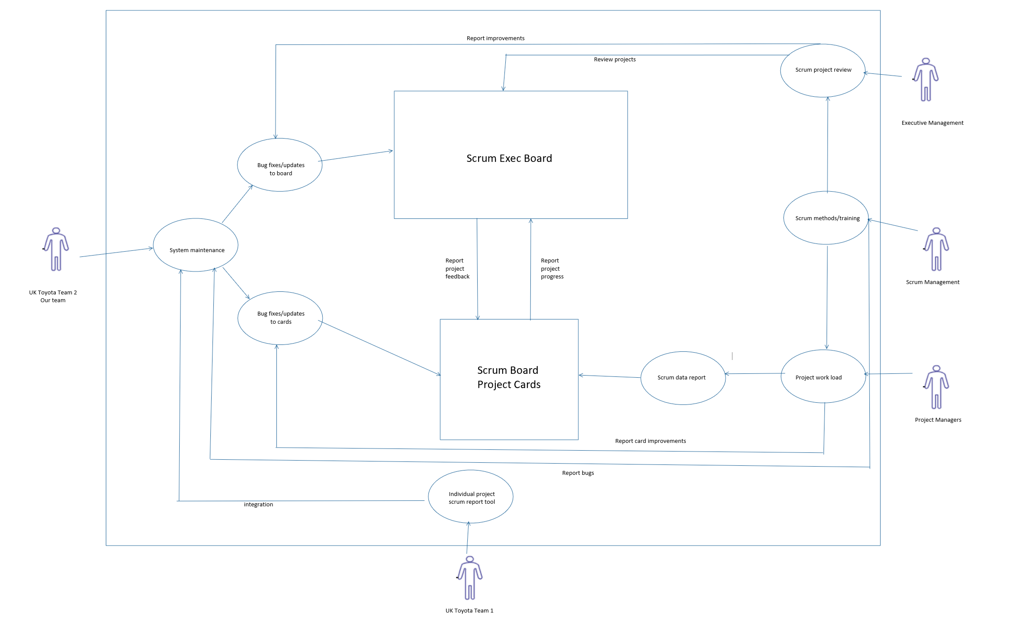
Use Case Scenarios

Slide 6
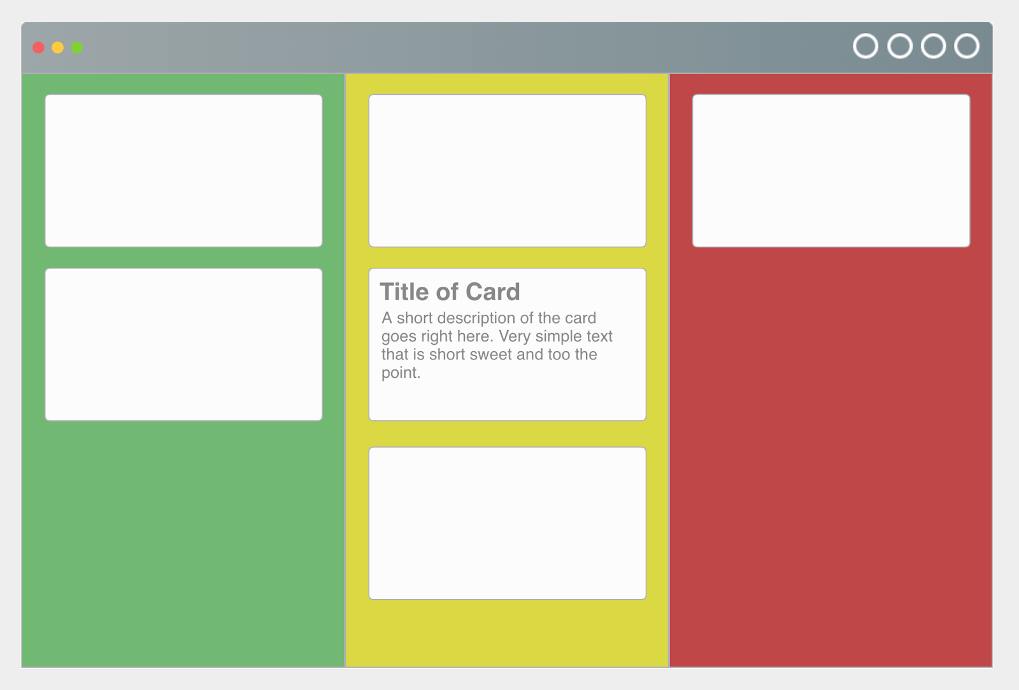
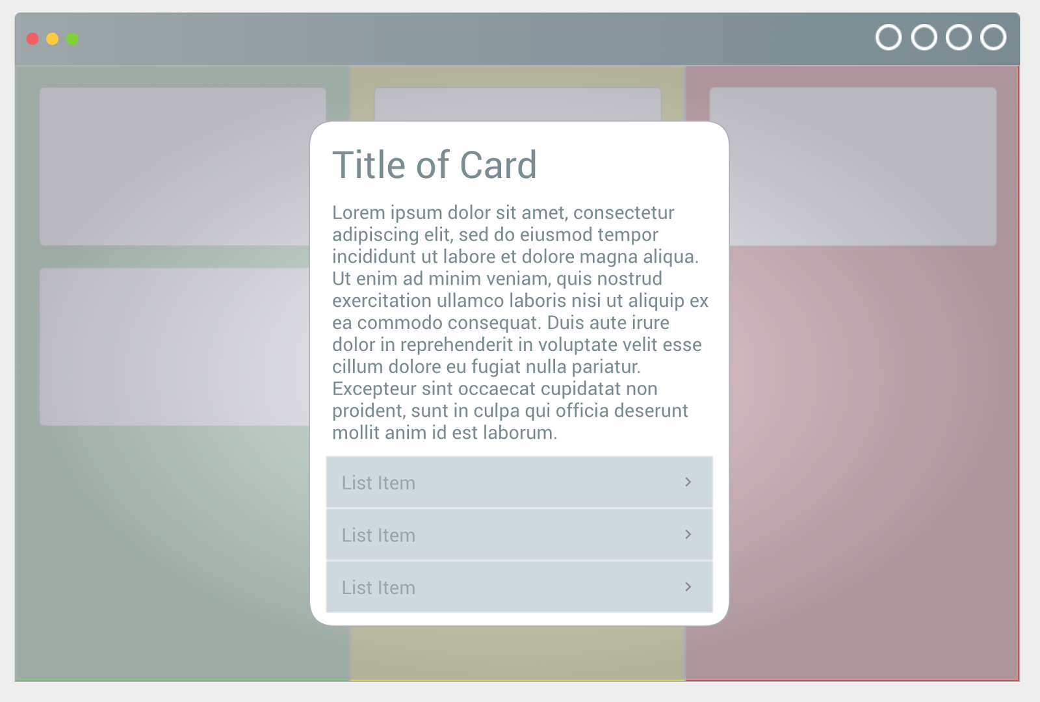
Basic Front End Design
Card View
Board View

Slide 7
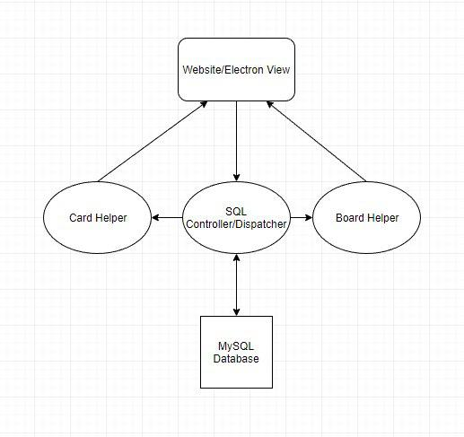
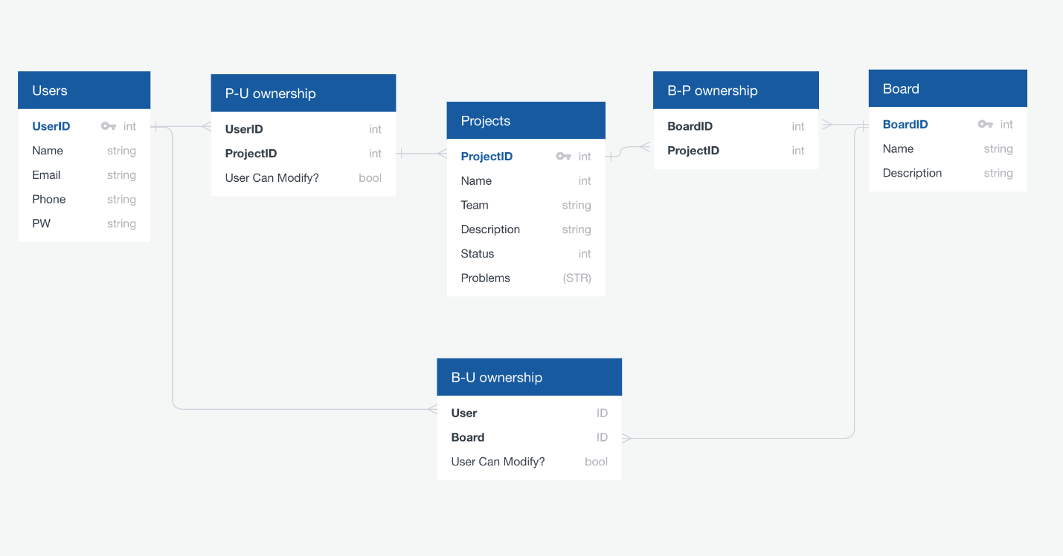
Basic Back End Diagrams
Class Diagram
Database Diagram

Slide 8
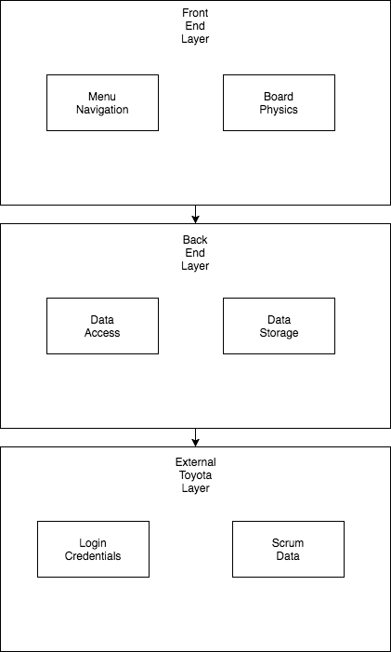
Architecture Model
UI Layer
Data Layer
External Scrum Layer

Slide 9
Team Review
Product Size
~40 active basic test cases
Product Effort
~20 man hours per person, all group work
Project Defects
We do not currently have any notable defects in our program.

Slide 10

Questions?

